Slide 1
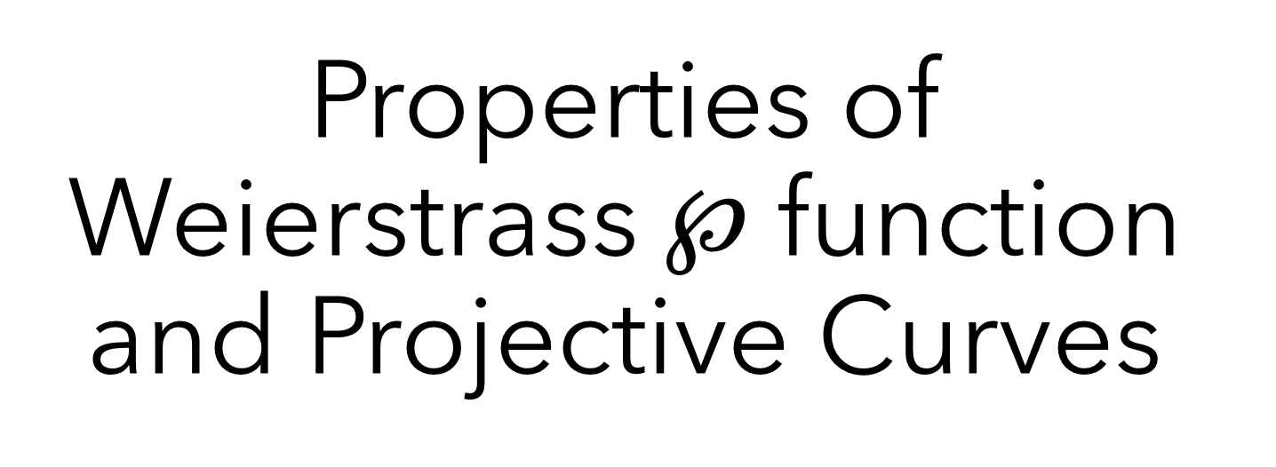
Properties of Weierstrass $℘$ function and Projective Curves
Maninder S. Dhanauta
December 20, 2022
University of Toronto Scarborough
MATD92 Mathematics Project – Riemann Surfaces
Public
Notes:
ID=d924773e-9a16-4d6d-9803-8cb819e99682 Recipe=text_billboard Type=TextOnly Variant=0 FamilyID=AccentBoxWalbaum_Zero

Slide 2
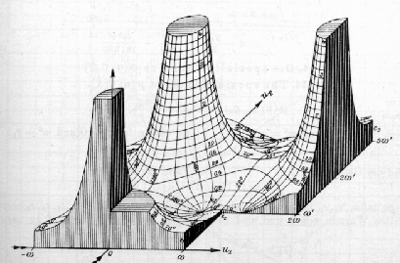

Agenda
Preliminary Results
Elliptic function and lattices
Weierstrass function
Properties of Elliptic function
Projective Curves as Riemann Surfaces
Holomorphic function $u: ℂ/Λ →C_{Λ}$
source
Notes:
Ask if they know
Cauchy sequence, metric space, what it means for metrics to be topologically equivalent

Slide 3
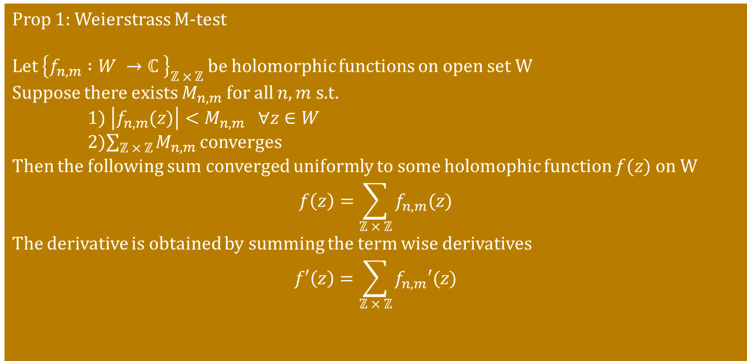
Preliminary Results
Prop 1: Weierstrass M-test
Let ${\left\{f_{n,m} :W →ℂ \right\}}_{ℤ × ℤ}$ be holomorphic functions on open set W
Suppose there exists $M_{n,m}$ for all $n, m$ s.t.
1) $\left|f_{n,m}(z)\right|<M_{n,m} ∀z∈W$
2)$\sum_{ℤ × ℤ}{M_{n,m}}$ converges
Then the following sum converged uniformly to some holomophic function $f(z)$ on W
$$f\left(z\right)=\sum_{ℤ × ℤ}{f_{n,m}(z)}$$
The derivative is obtained by summing the term wise derivatives
$$f′\left(z\right)=\sum_{ℤ × ℤ}{f_{n,m}′(z)}$$
Notes:
Isolated zeros of non-constant holomophic functions
Valency and related questions
Implicit function theorem

Slide 4
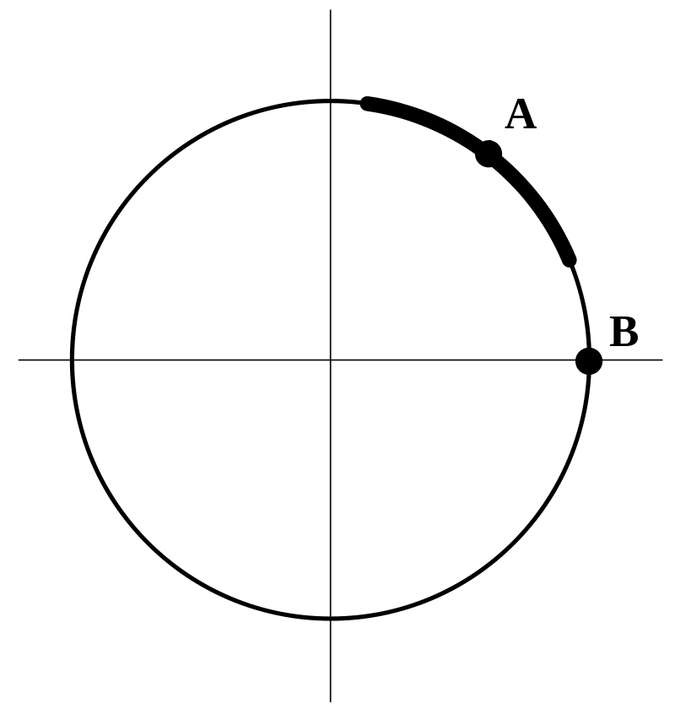
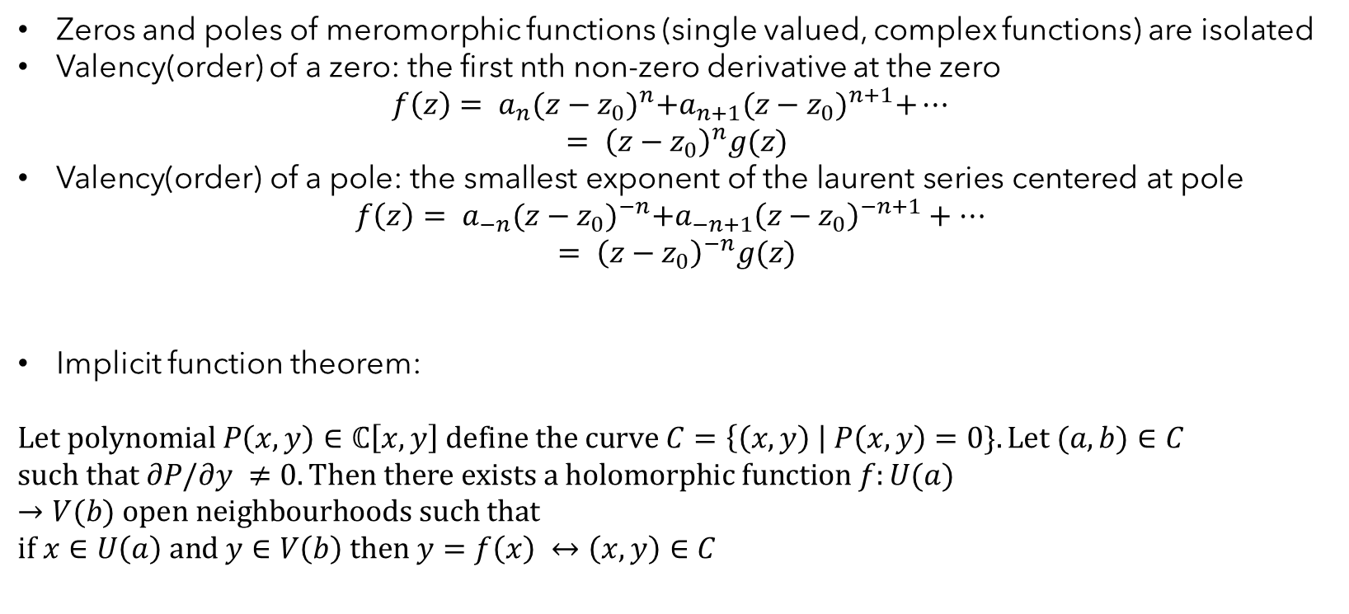
Preliminary Results
Zeros and poles of meromorphic functions (single valued, complex functions) are isolated
Valency(order) of a zero: the first nth non-zero derivative at the zero
$$f\left(z\right)= a_{n}{(z−z_{0})}^{n}+a_{n+1}{(z−z_{0})}^{n+1}+…$$
$$= {\left(z−z_{0}\right)}^{n}g(z)$$
$\text{Valency}\text{(}\text{order}\text{) }\text{of} \text{a} \text{pole}\text{: }\text{the} \text{smallest} \text{exponent} \text{of} \text{the} \text{laurent} \text{series} \text{centered} \text{at} \text{pole}$
$$f\left(z\right)= a_{−n}{(z−z_{0})}^{−n}+a_{−n+1}{\left(z−z_{0}\right)}^{−n+1}+…$$
$$= {\left(z−z_{0}\right)}^{−n}g(z)$$
Implicit function theorem:
$$Let polynomial P\left(x,y\right)∈ℂ\left[x,y\right] define the curve C=\left\{\left(x,y\right) \right| P\left(x,y\right)=0\}. Let (a,b)∈C$$
$$such that ∂P/∂y ≠0. Then there exists a holomorphic function f:U(a)→V(b) open neighbourhoods such that$$
$$if x∈U\left(a\right) and y∈V\left(b\right) then y=f\left(x\right) ↔\left(x,y\right)∈C$$

Slide 5
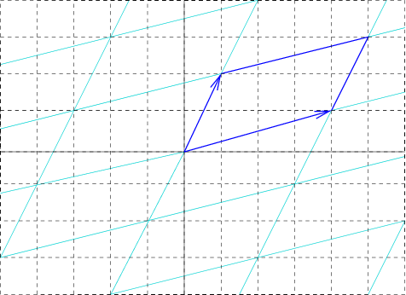
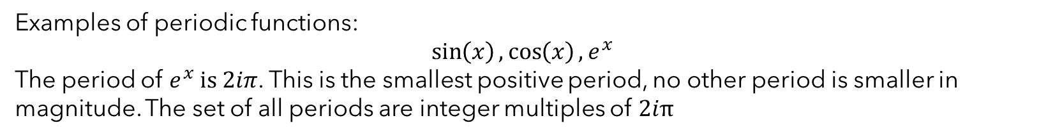
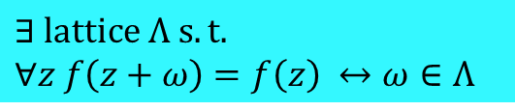
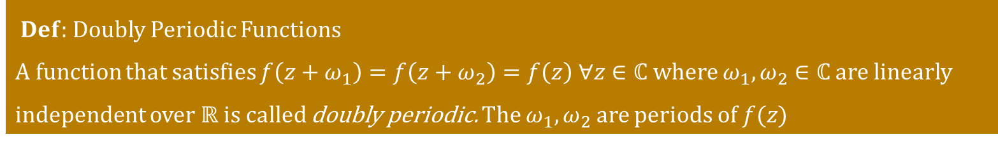
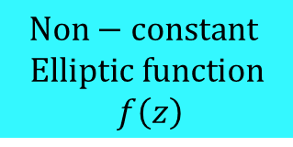
Elliptic Function and Lattices
$Def:$ Doubly Periodic Functions
A function that satisfies $f\left(z+ω_{1}\right)=f\left(z+ω_{2}\right)=f\left(z\right) ∀z∈ℂ$ where $ω_{1}, ω_{2}∈ℂ$ are linearly independent over $ℝ$ is called doubly periodic. The $ω_{1}, ω_{2}$ are periods of $f(z)$
Examples of periodic functions:
$$\sin\left(x\right),\cos\left(x\right), e^{x}$$
The period of $e^{x} is 2iπ$. This is the smallest positive period, no other period is smaller in magnitude. The set of all periods are integer multiples of $2iπ$
$Def:$ Lattice is the set $Λ=\left\{ nω_{1}+mω_{2}\right| \left(n,m\right)∈ℤ \}$
$Def:$ Elliptic Function $f(z)$ is a meromorphic and doubly periodic functions
$$Non−constant$$
$$Elliptic function$$
$$f\left(z\right)$$
$$∃ lattice Λ s.t.$$
$$∀z f\left(z+ω\right)=f\left(z\right) ↔ω∈Λ$$
What generates the lattice?

Slide 6
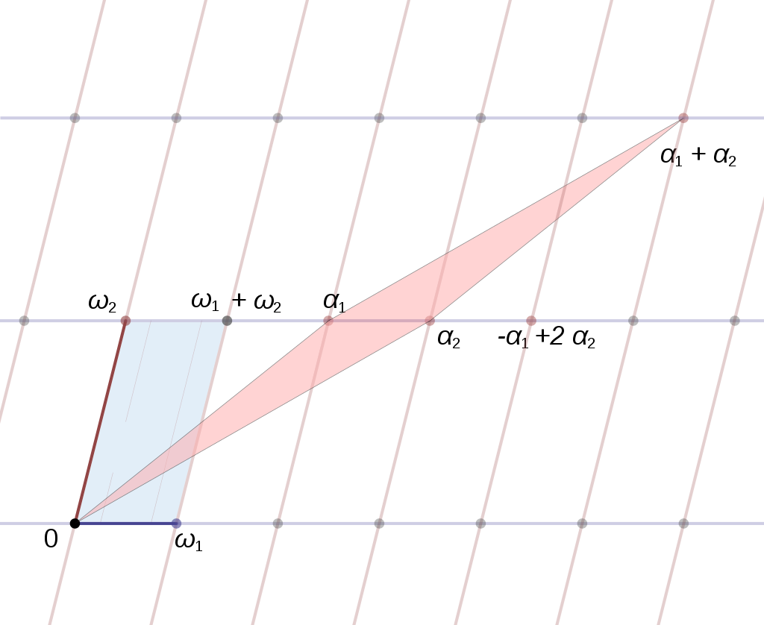
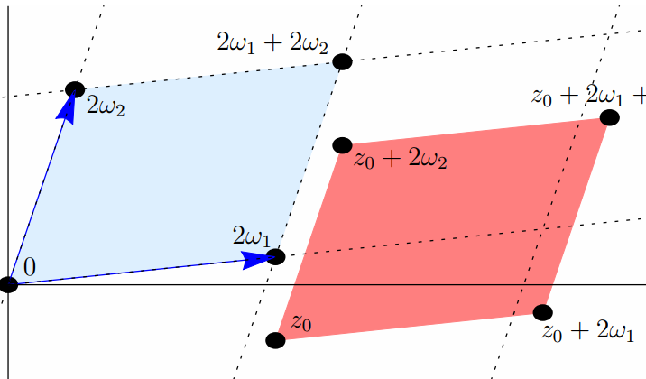
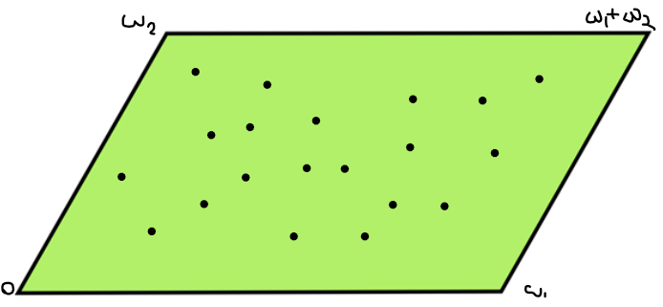

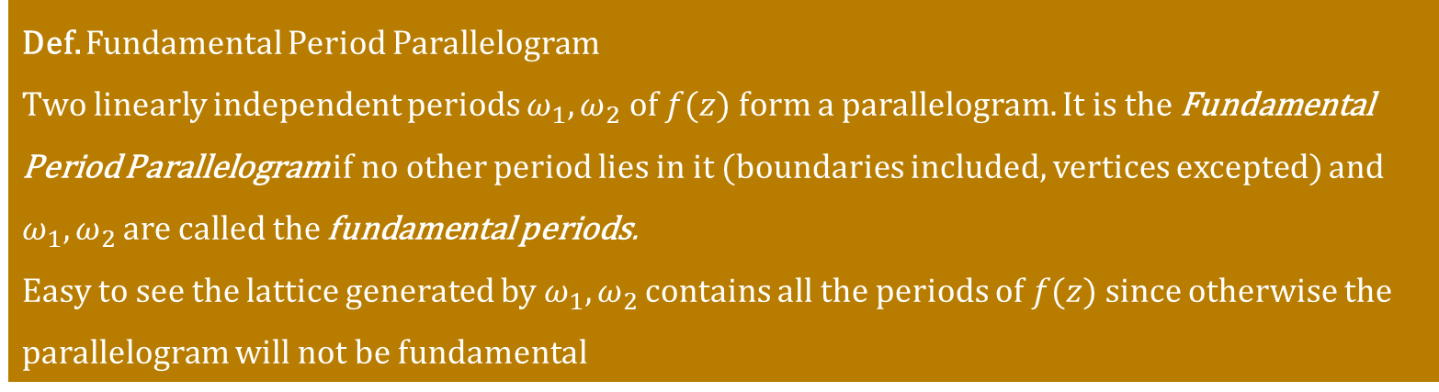
Elliptic Function and Lattices
Def. Fundamental Period Parallelogram
Two linearly independent periods $ω_{1},ω_{2} of f(z)$ form a parallelogram. It is the Fundamental Period Parallelogram if no other period lies in it (boundaries included, vertices excepted) and $ω_{1},ω_{2}$ are called the fundamental periods.
Easy to see the lattice generated by $ω_{1},ω_{2}$ contains all the periods of $f(z)$ since otherwise the parallelogram will not be fundamental
We can translate the fundamental period parallelogram by adding $z_{0}$ to get a cell, denoted $P\left(z_{0}\right)$
Why should there exists a fundamental Period Parallelogram?
[pf: Conv. Subsequence +
isolated zeros/poles]
Notes:
Now we can say period of f is same as point in the lattice

Slide 7
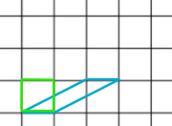
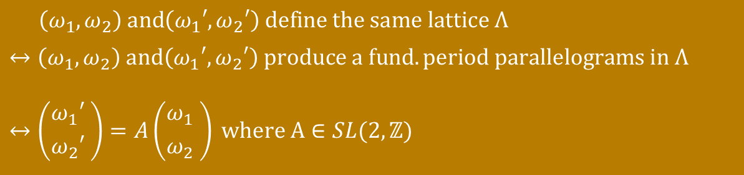
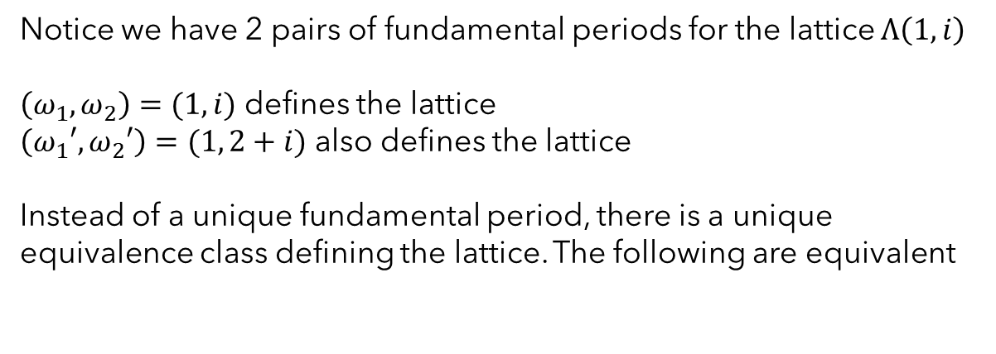
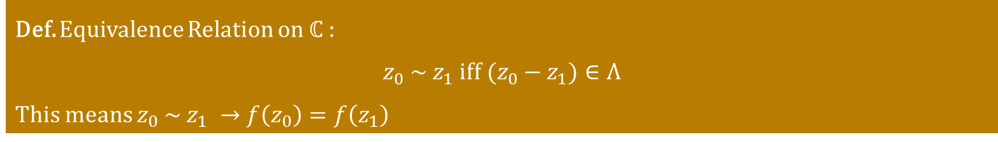
Choice of Fundamental Periods
Notice we have 2 pairs of fundamental periods for the lattice $Λ\left(1,i\right)$
$\left(ω_{1},ω_{2}\right)=(1,i)$ defines the lattice
$\left(ω_{1}′,ω_{2}′\right)=(1, 2+i)$ also defines the lattice
Instead of a unique fundamental period, there is a unique equivalence class defining the lattice. The following are equivalent
$\left(ω_{1},ω_{2}\right) and\left(ω_{1}′,ω_{2}′\right) define the same lattice Λ$
$$↔\left(ω_{1},ω_{2}\right) and\left(ω_{1}′,ω_{2}′\right) produce a fund. period parallelograms in Λ$$
$$↔\left({ω_{1}′ \atop ω_{2}′} \right)=A\left({ω_{1} \atop ω_{2}} \right) where A∈SL(2,ℤ)$$
Def. Equivalence Relation on $ℂ$ :
$$z_{0} \sim z_{1} iff (z_{0}−z_{1})∈Λ$$
This means $z_{0} \sim z_{1} →f\left(z_{0}\right)=f\left(z_{1}\right)$
Notes:
Proof is related to minimum area property, matrix A doesn’t change volume so intuitively should be fund. parall.

Slide 8
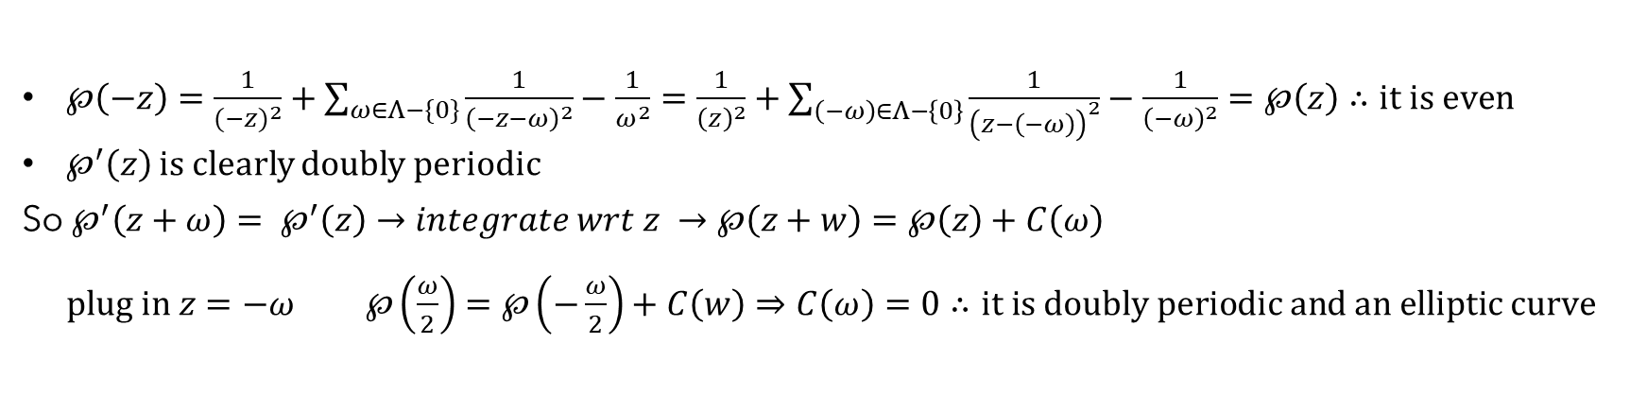
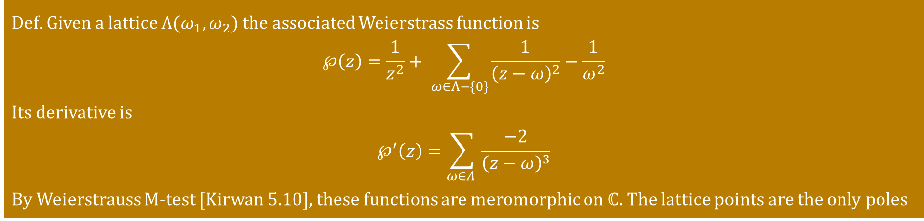
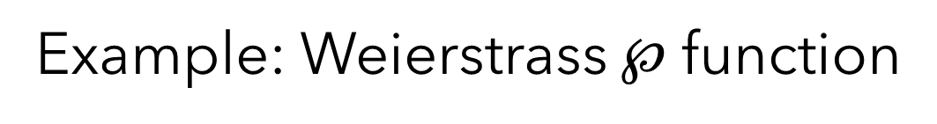
Example: Weierstrass $℘$ function
Def. Given a lattice $Λ(ω_{1},ω_{2})$ the associated Weierstrass function is
$$℘\left(z\right)=\frac{1}{z^{2}}+ \sum_{ω∈Λ−\{0\}}{\frac{1}{{\left(z−ω\right)}^{2}}}−\frac{1}{ω^{2}}$$
Its derivative is
$$℘^{′}\left(z\right)=\sum_{ω∈Λ }{\frac{−2}{{\left(z−ω\right)}^{3}}}$$
By Weierstrauss M-test [Kirwan 5.10], these functions are meromorphic on $ℂ$. The lattice points are the only poles
Prop. $℘$ is even and doubly periodic (i.e. periodic on the lattice $Λ$)
$℘\left(−z\right)=\frac{1}{{(−z)}^{2}}+\sum_{ω∈Λ−\{0\}}{\frac{1}{{\left(−z−ω\right)}^{2}}}−\frac{1}{ω^{2}}=\frac{1}{{\left(z\right)}^{2}}+\sum_{\left(−ω\right)∈Λ−\left\{0\right\}}{\frac{1}{{\left(z−\left(−ω\right)\right)}^{2}}}−\frac{1}{{\left(−ω\right)}^{2}}=℘\left(z\right)∴it is even$
$℘^{′}\left(z\right)$ is clearly doubly periodic
So $℘^{′}\left(z+ω\right)= ℘^{′}\left(z\right)→integrate wrt z →℘\left(z+w\right)=℘\left(z\right)+C\left(ω\right)$
$plug in z=−ω ℘\left(\frac{ω}{2}\right)=℘\left(−\frac{ω}{2}\right)+C\left(w\right)⇒C\left(ω\right)=0∴it is doubly periodic and an elliptic curve$
Notes:
Now we can say period of f is same as point in the lattice

Slide 9
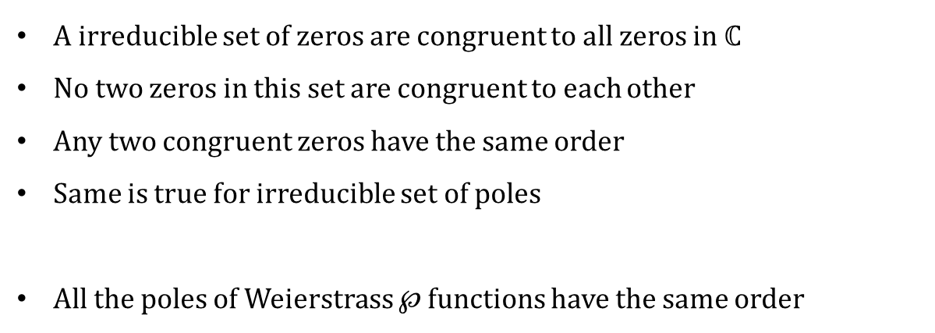
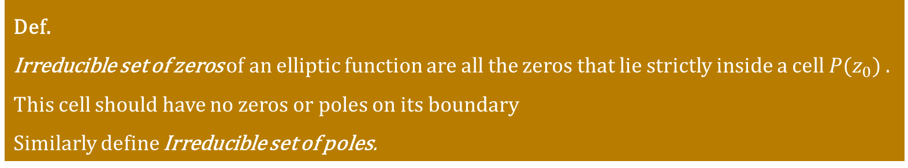
Def.
Irreducible set of zeros of an elliptic function are all the zeros that lie strictly inside a cell $P(z_{0})$ . This cell should have no zeros or poles on its boundary
Similarly define Irreducible set of poles.
A irreducible set of zeros are congruent to all zeros in $ℂ$
No two zeros in this set are congruent to each other
Any two congruent zeros have the same order
Same is true for irreducible set of poles
All the poles of Weierstrass $℘$ functions have the same order
Notes:
Proof is related to minimum area property, matrix A doesn’t change volume so intuitively should be fund. parall.

Slide 10
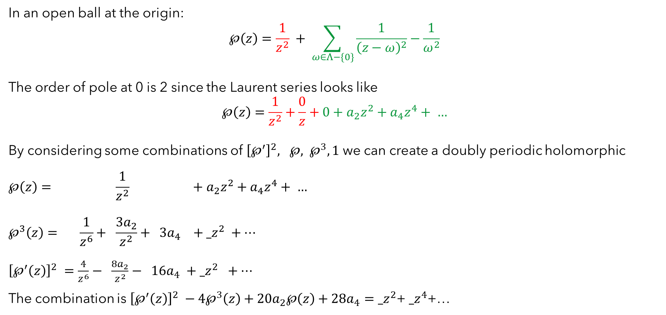
Laurent Series $@z=0$ and order of poles
In an open ball at the origin:
$$℘\left(z\right)=\frac{1}{z^{2}} + \sum_{ω∈Λ−\{0\}}{\frac{1}{{\left(z−ω\right)}^{2}}}−\frac{1}{ω^{2}}$$
The order of pole at 0 is 2 since the Laurent series looks like
$$℘\left(z\right)=\frac{1}{z^{2}}+\frac{0}{z}+0+a_{2}z^{2}+a_{4}z^{4}+ …$$
By considering some combinations of ${\left[℘^{′}\right]}^{2}, ℘, ℘^{3}, 1$we can create a doubly periodic holomorphic
$$℘\left(z\right)= \frac{1}{z^{2}} +a_{2}z^{2}+a_{4}z^{4}+ …$$
$$℘^{3}\left(z\right)= \frac{1}{z^{6}}+ \frac{{3a}_{2}}{z^{2}}+ {3a}_{4} +{_z}^{2} +…$$
${\left[℘^{′}\left(z\right)\right]}^{2} =\frac{4}{z^{6}}− \frac{{8a}_{2}}{z^{2}}− {16a}_{4} +$ ${_z}^{2} +…$
The combination is ${\left[℘^{′}\left(z\right)\right]}^{2} −4℘^{3}\left(z\right)+20a_{2}℘\left(z\right)+28a_{4}={_z}^{2}$+ ${_z}^{4}$+…
Notes:
Mention that residue is 0

Slide 11
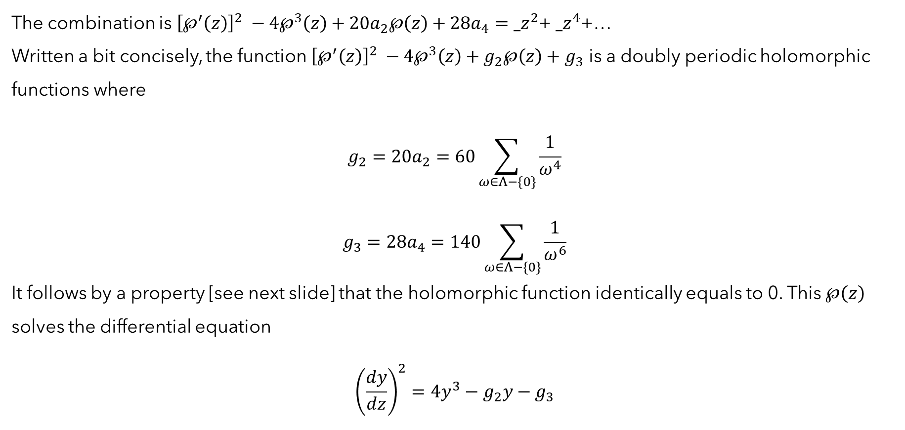
Laurent Series $@z=0$ and order of poles
The combination is ${\left[℘^{′}\left(z\right)\right]}^{2} −4℘^{3}\left(z\right)+20a_{2}℘\left(z\right)+28a_{4}={_z}^{2}$+ ${_z}^{4}$+…
Written a bit concisely, the function ${\left[℘^{′}\left(z\right)\right]}^{2} −4℘^{3}\left(z\right)+g_{2}℘\left(z\right)+g_{3}$ is a doubly periodic holomorphic functions where
$$g_{2}=20a_{2}=60\sum_{ω∈Λ−\{0\}}{\frac{1}{ω^{4}}}$$
$$g_{3}=28a_{4}=140\sum_{ω∈Λ−\{0\}}{\frac{1}{ω^{6}}}$$
It follows by a property [see next slide] that the holomorphic function identically equals to 0. This $℘\left(z\right)$ solves the differential equation
$${\left(\frac{dy}{dz}\right)}^{2}=4y^{3}−g_{2}y−g_{3}$$

Slide 12
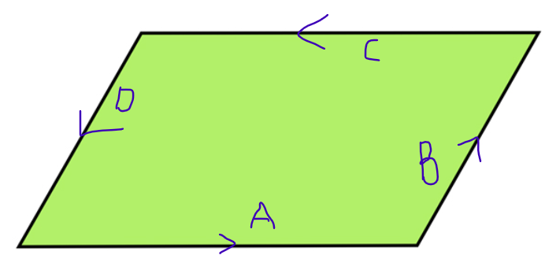
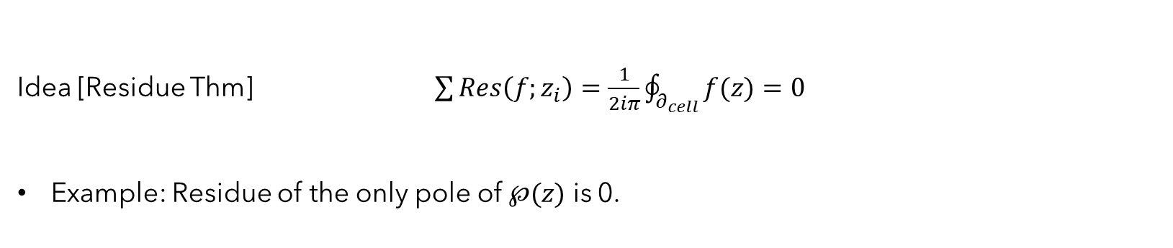
Properties of Elliptic function
Sum of Residues over an irreducible set of poles of an elliptic function is 0
Idea [Residue Thm] $\sum{Res\left(f;z_{i}\right)}=\frac{1}{2iπ}\oint_{∂_{cell}}{f(z)}=0$
Example: Residue of the only pole of $℘(z)$ is 0.
2) A holomorphic elliptic function is constant
Idea [ continuous function bounded on compact parallelogram + periodic + Liouville’s Thm]

Slide 13
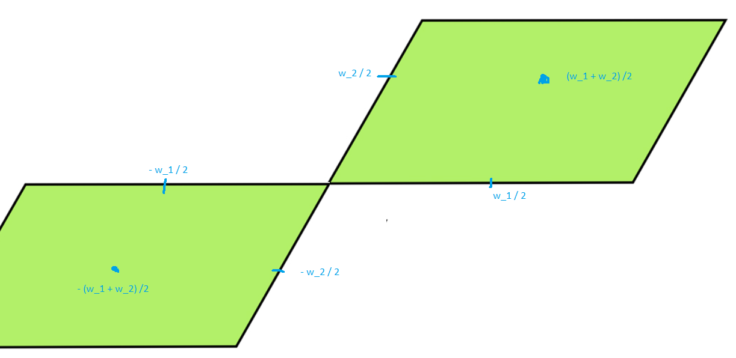
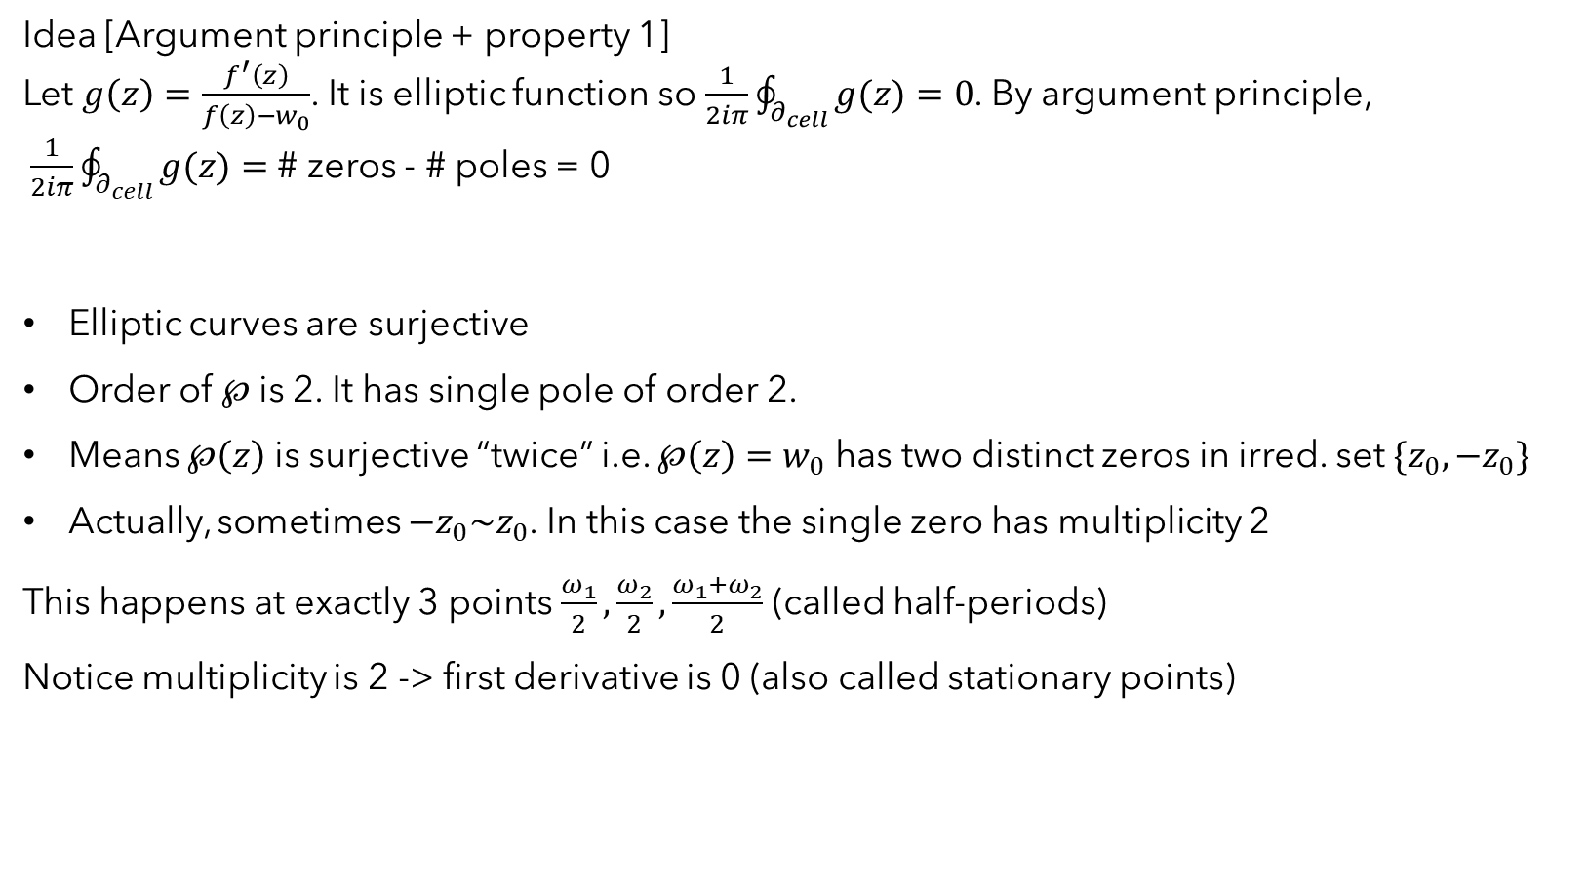
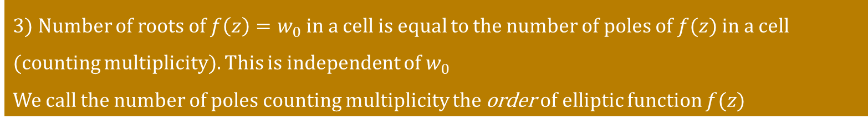
3) Number of roots of $f\left(z\right)=w_{0}$in a cell is equal to the number of poles of $f(z)$ in a cell (counting multiplicity). This is independent of $w_{0}$
We call the number of poles counting multiplicity the order of elliptic function $f(z)$
Idea [Argument principle + property 1]
Let $g\left(z\right)=\frac{f^{′}\left(z\right)}{f\left(z\right)−w_{0}}$. It is elliptic function so $\frac{1}{2iπ}\oint_{∂_{cell}}{g(z)}=0$. By argument principle, $\frac{1}{2iπ}\oint_{∂_{cell}}{g(z)}=$ # zeros - # poles = 0
Elliptic curves are surjective
Order of $℘$is 2. It has single pole of order 2.
Means $℘\left(z\right)$ is surjective “twice” i.e. $℘\left(z\right)=w_{0}$ has two distinct zeros in irred. set $\{z_{0},−z_{0}\}$
Actually, sometimes $−z_{0}\sim z_{0}$. In this case the single zero has multiplicity 2
This happens at exactly 3 points $\frac{ω_{1}}{2},\frac{ω_{2}}{2},\frac{{ω_{1}+ω}_{2}}{2}$ (called half-periods)
Notice multiplicity is 2 -> first derivative is 0 (also called stationary points)

Slide 14
4) The smallest order of an elliptic function is 2
Weierstrass $℘\left(z\right)$ function, which has order 2, has the smallest possible order

Slide 15
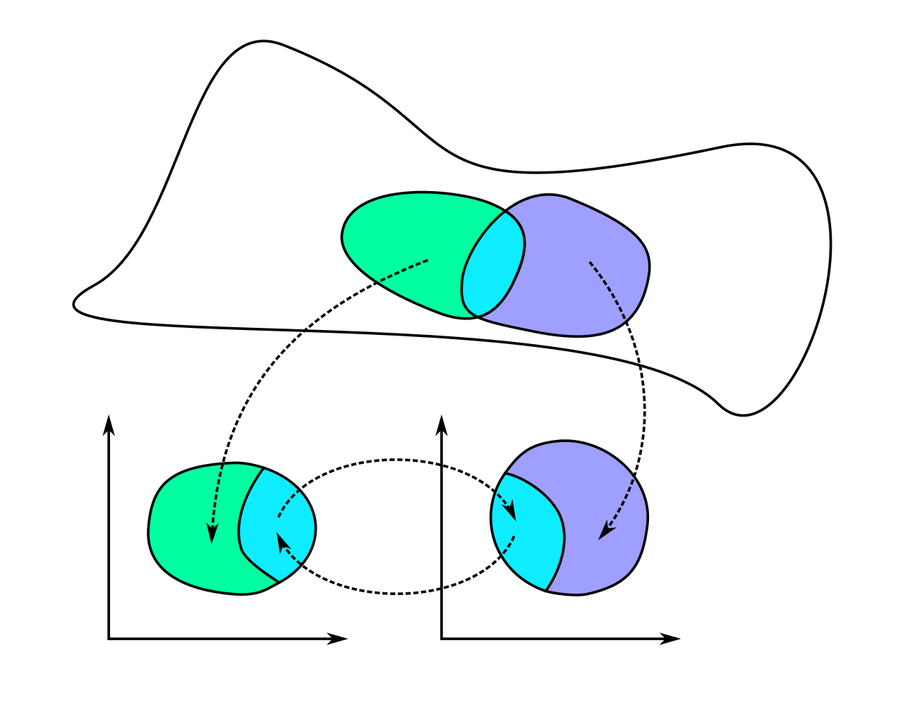
4) The smallest order of an elliptic function is 2
Weierstrass $℘\left(z\right)$ function, which has order 2, has the smallest possible order
Riemann surfaces have holomorphic transition maps

Slide 16
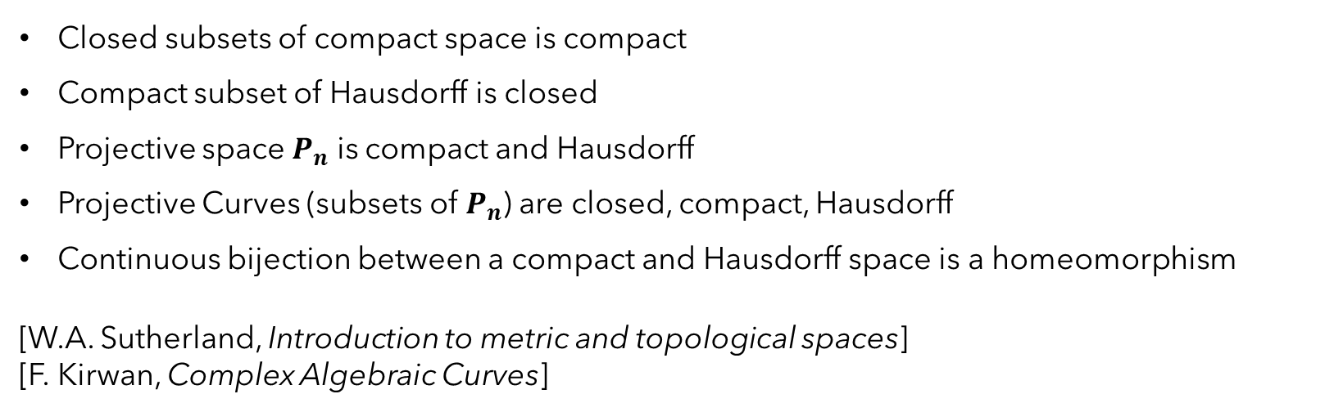
Some More Preliminary Results
Closed subsets of compact space is compact
Compact subset of Hausdorff is closed
Projective space $P_{n}$ is compact and Hausdorff
Projective Curves (subsets of $P_{n}$) are closed, compact, Hausdorff
Continuous bijection between a compact and Hausdorff space is a homeomorphism
[W.A. Sutherland, Introduction to metric and topological spaces]
[F. Kirwan, Complex Algebraic Curves]

Slide 17
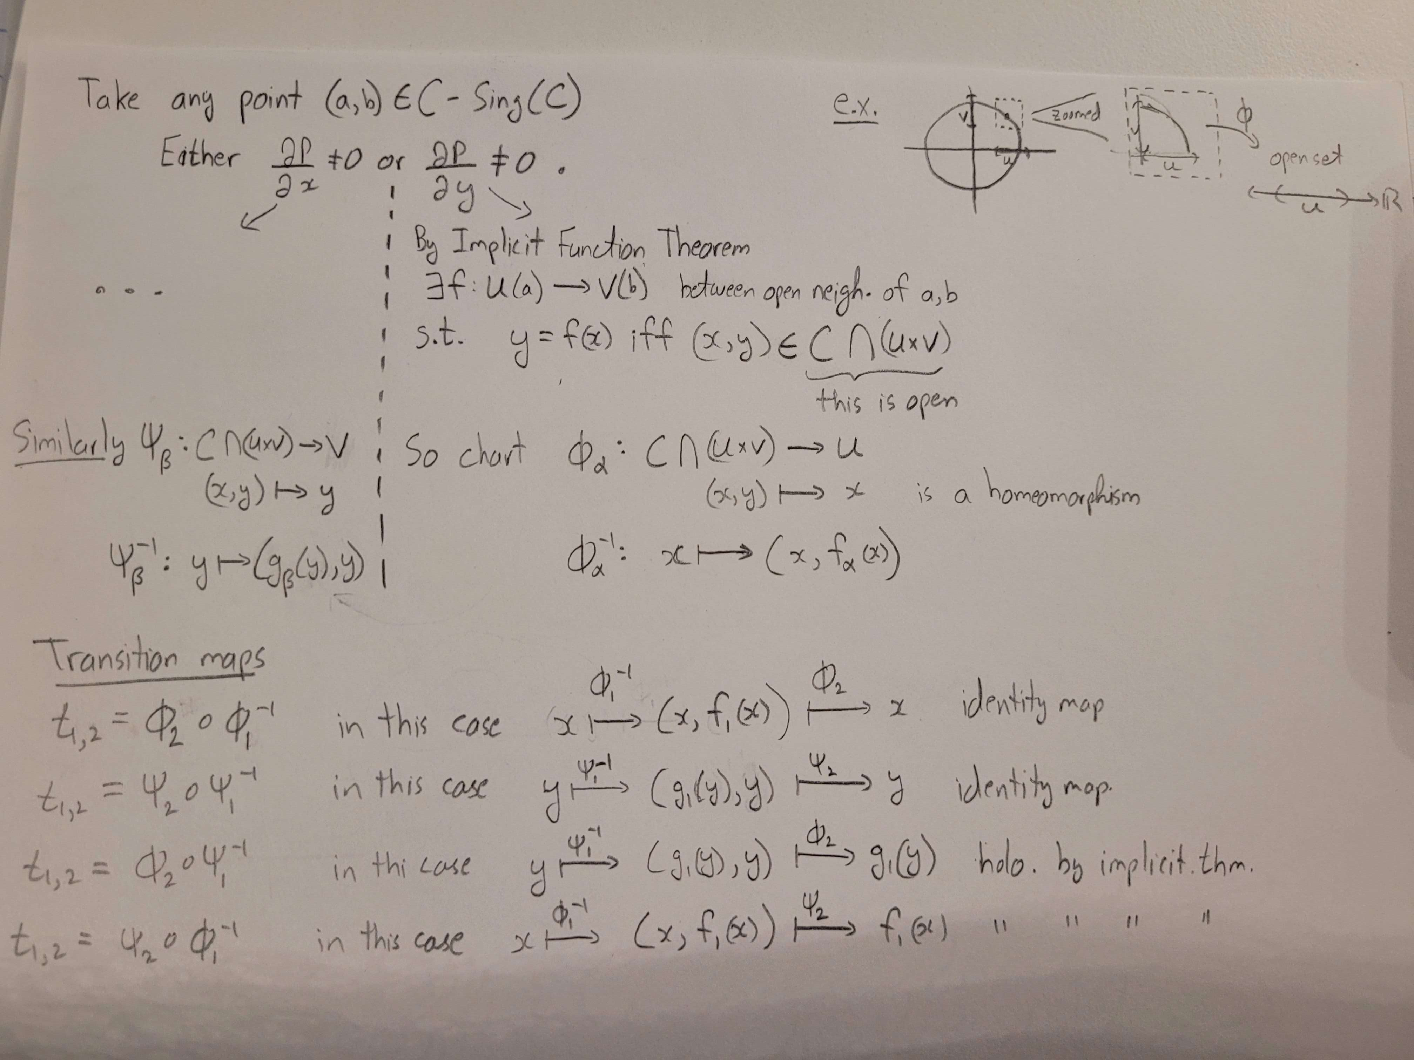
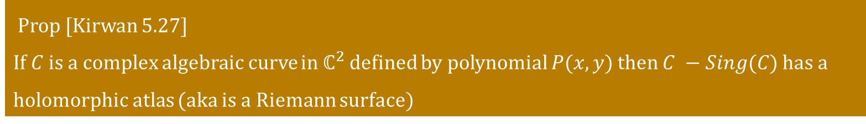
Complex Algebraic Curves as Riemann Surfaces
Prop [Kirwan 5.27]
If $C$ is a complex algebraic curve in $ℂ^{2}$ defined by polynomial $P(x,y)$ then $C −Sing(C)$ has a holomorphic atlas (aka is a Riemann surface)

Slide 18
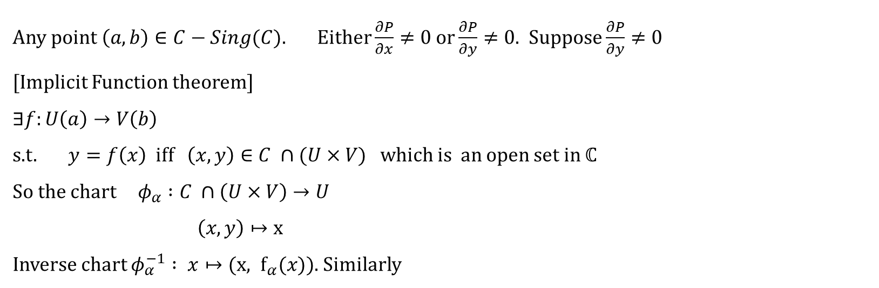
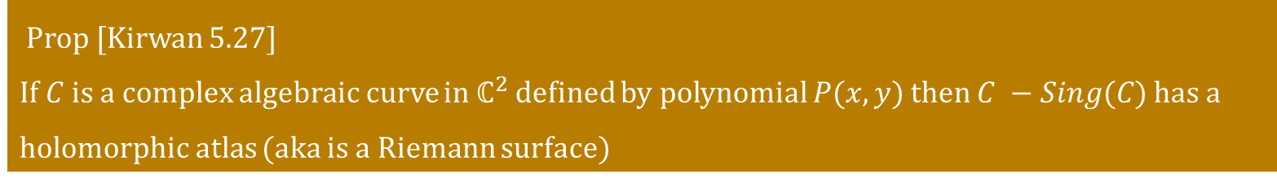
Complex Algebraic Curves as Riemann Surfaces
Prop [Kirwan 5.27]
If $C$ is a complex algebraic curve in $ℂ^{2}$ defined by polynomial $P(x,y)$ then $C −Sing(C)$ has a holomorphic atlas (aka is a Riemann surface)
Any point$\left(a,b\right)∈C−Sing(C)$. Either $\frac{∂P}{∂x}≠0 or\frac{∂P}{∂y}≠0$. Suppose $\frac{∂P}{∂y}≠0$
[Implicit Function theorem]
$$∃f:U\left(a\right)→V\left(b\right)$$
s.t. $y=f\left(x\right) iff \left(x,y\right)∈C ∩(U×V)$ which is an open set in $ℂ$
So the chart $φ_{α} :C ∩\left(U×V\right)→U$
$\left(x,y\right)↦x$
Inverse chart $φ_{α}^{−1} : x↦(x, f_{α}(x))$. Similarly

Slide 19
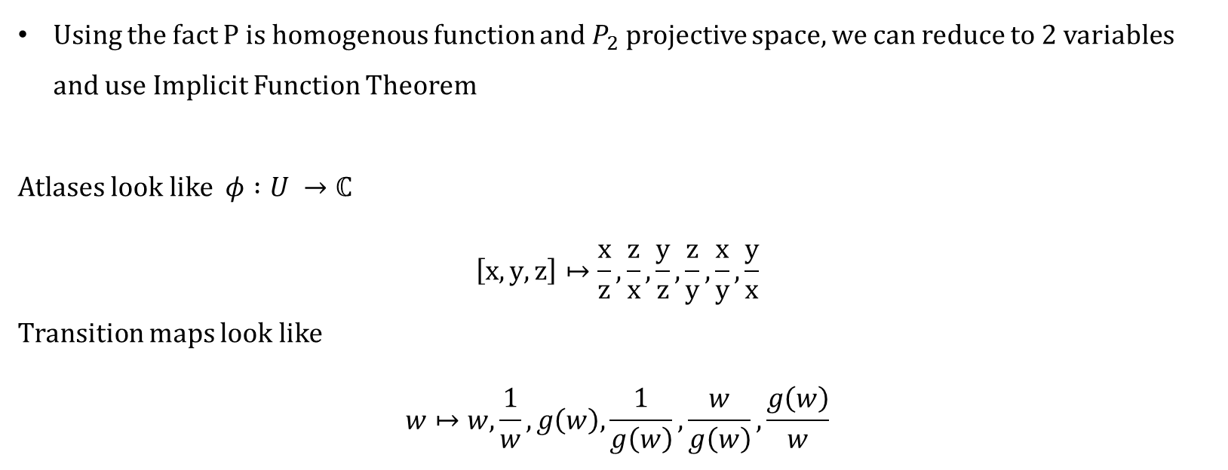
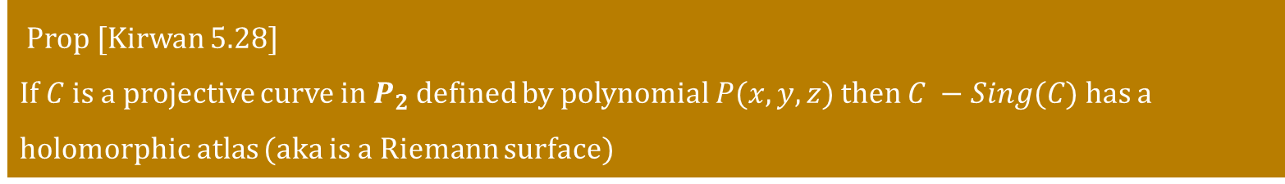
Projective Curves as Riemann Surfaces
Prop [Kirwan 5.28]
If $C$ is a projective curve in $P_{2}$ defined by polynomial $P(x,y, z)$ then $C −Sing(C)$ has a holomorphic atlas (aka is a Riemann surface)
Using the fact P is homogenous function and $P_{2}$projective space, we can reduce to 2 variables and use Implicit Function Theorem
Atlases look like $φ :U →ℂ$
$$\left[x, y, z\right]↦\frac{x}{z}, \frac{z}{x},\frac{y}{z},\frac{z}{y},\frac{x}{y},\frac{y}{x}$$
Transition maps look like
$$w↦w, \frac{1}{w}, g\left(w\right),\frac{1}{g\left(w\right)},\frac{w}{g\left(w\right)},\frac{g\left(w\right)}{w}$$

Slide 20
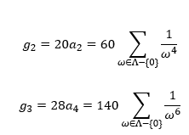


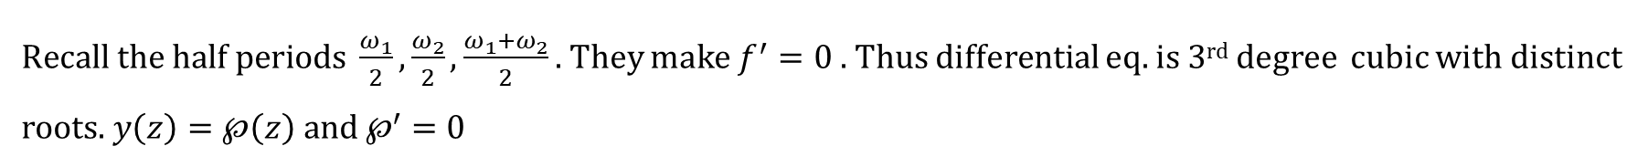
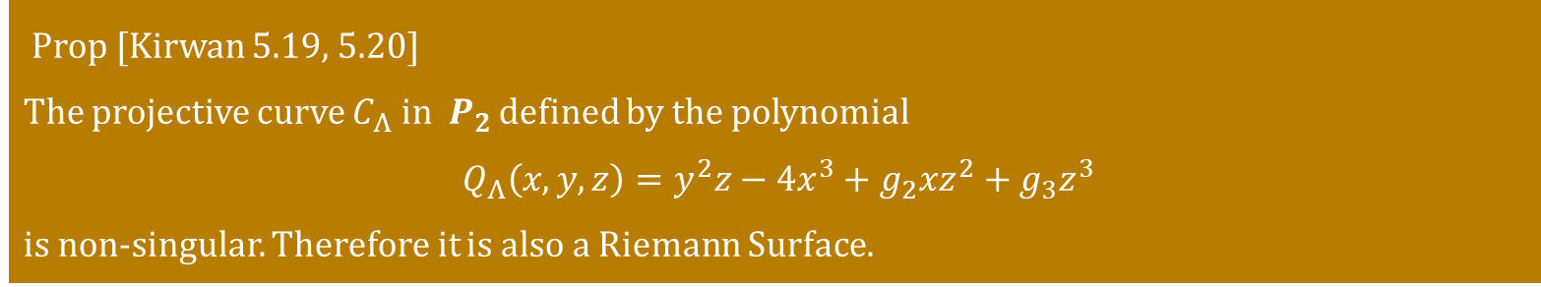
Projective Curves as Riemann Surfaces
Prop [Kirwan 5.19, 5.20]
The projective curve $C_{Λ} in P_{2}$ defined by the polynomial
$Q_{Λ}\left(x,y,z\right)=y^{2}z−4x^{3}+g_{2}xz^{2}+g_{3}z^{3}$
is non-singular. Therefore it is also a Riemann Surface.
$Recall the half periods \frac{ω_{1}}{2},\frac{ω_{2}}{2},\frac{{ω_{1}+ω}_{2}}{2}$ . They make $f^{′}=0$. Thus differential eq. is 3rd degree cubic with distinct roots. $y\left(z\right)=℘\left(z\right) and ℘^{′}=0$

Slide 21
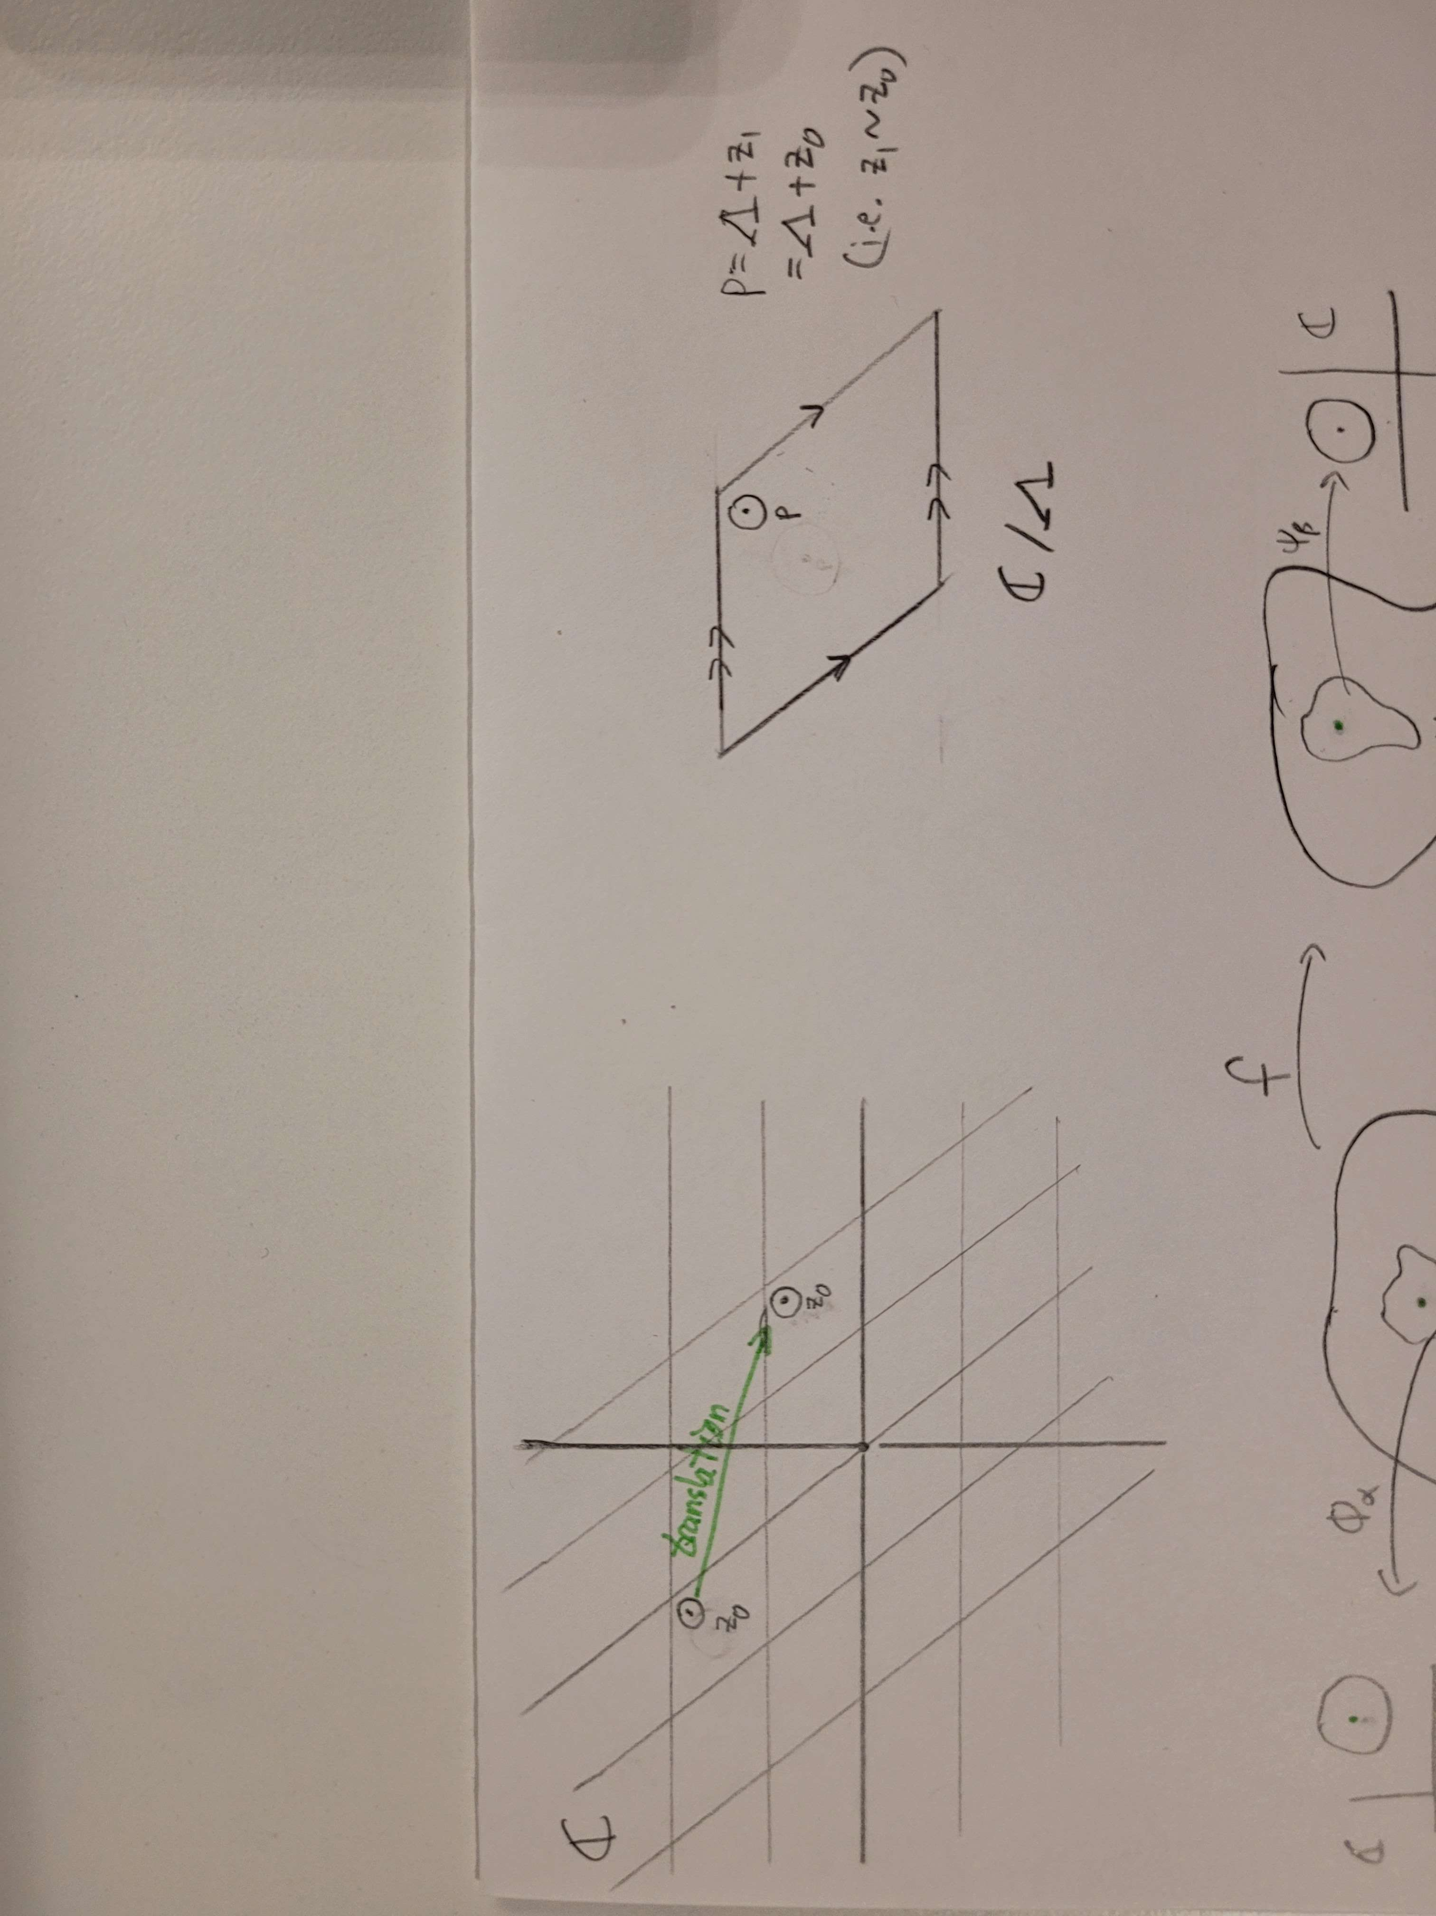
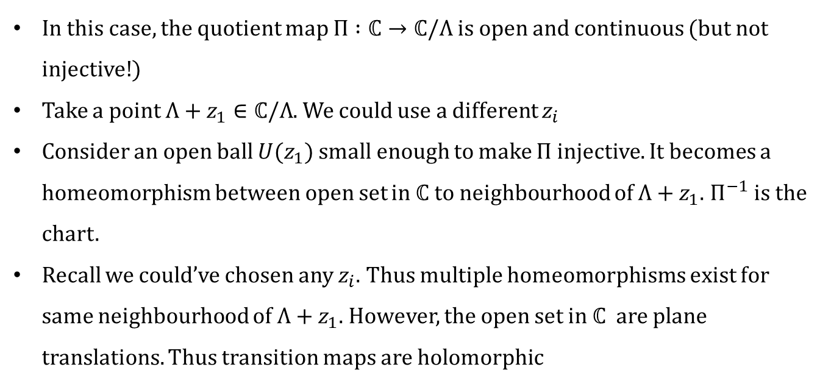
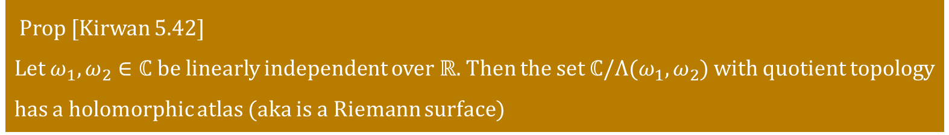
Complex Torus as Riemann Surfaces
Prop [Kirwan 5.42]
Let $ω_{1},ω_{2}∈ℂ$ be linearly independent over $ℝ$. Then the set $ℂ/Λ(ω_{1},ω_{2})$ with quotient topology has a holomorphic atlas (aka is a Riemann surface)
In this case, the quotient map $Π :ℂ→ℂ/Λ$ is open and continuous (but not injective!)
Take a point $Λ+z_{1}∈ℂ/Λ$. We could use a different $z_{i}$
Consider an open ball $U(z_{1})$ small enough to make $Π$ injective. It becomes a homeomorphism between open set in $ℂ$ to neighbourhood of $Λ+z_{1}$. $Π^{−1}$ is the chart.
Recall we could’ve chosen any $z_{i}$. Thus multiple homeomorphisms exist for same neighbourhood of $Λ+z_{1}$. However, the open set in $ℂ$ are plane translations. Thus transition maps are holomorphic

Slide 22
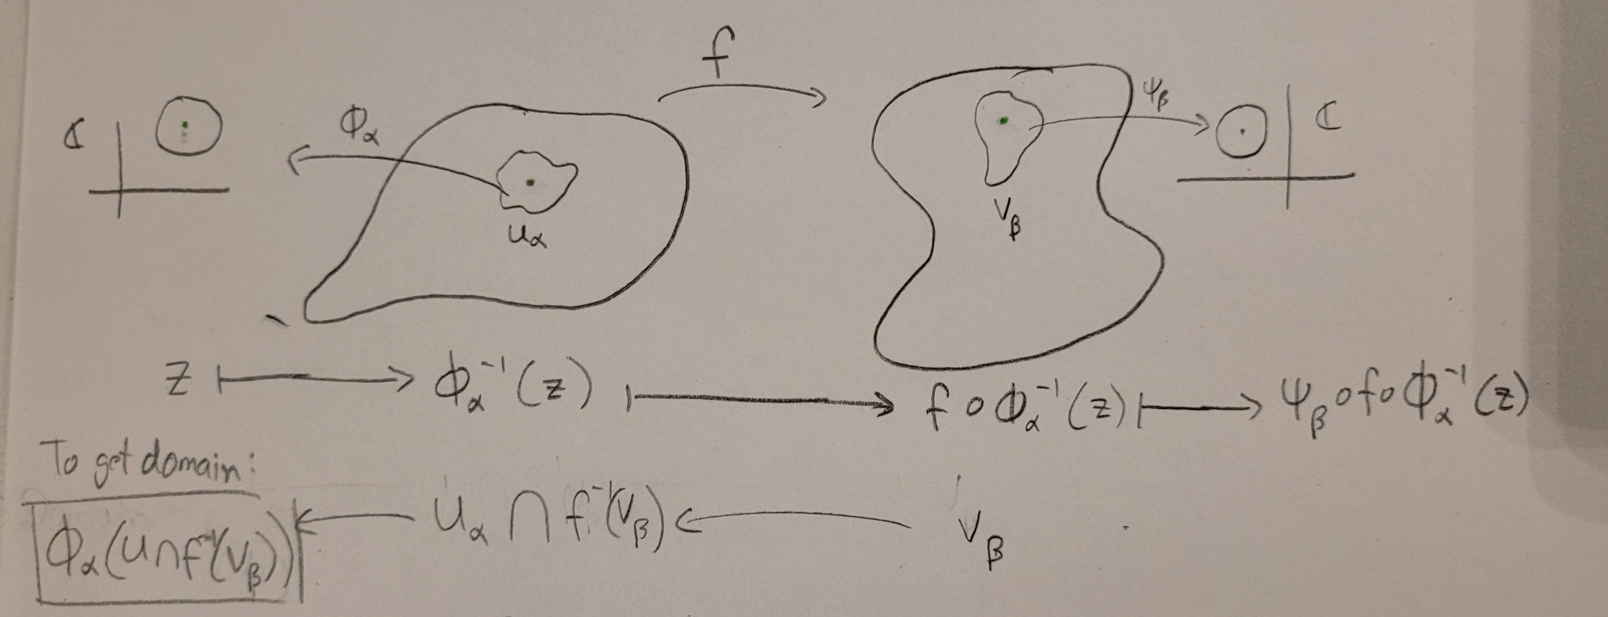
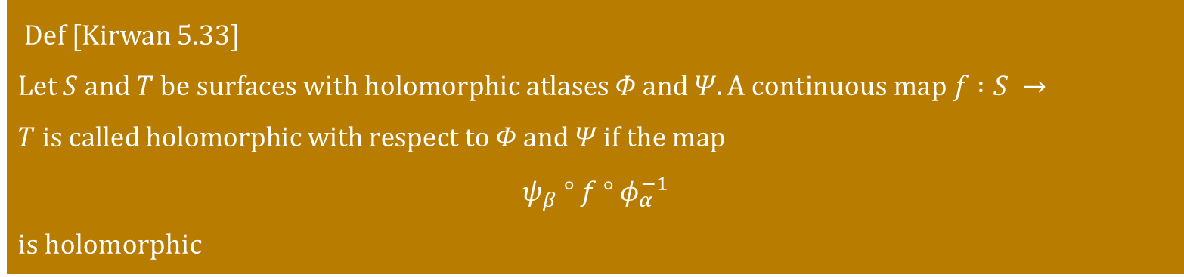
Holomorphic maps between Riemann surfaces
Def [Kirwan 5.33]
Let $S and T be surfaces with holomorphic atlases Φ and Ψ. A continuous map f :S →T is called holomorphic with respect to Φ and Ψ if the map$
$$ψ_{β} ° f ° φ_{α}^{−1}$$
is holomorphic
Equivalently, it can be defined pointwise by asking if there exists 2 charts the cover the point and its image under f such that $ψ_{β} ° f ° φ_{α}^{−1}$ is holomorphic

Slide 23
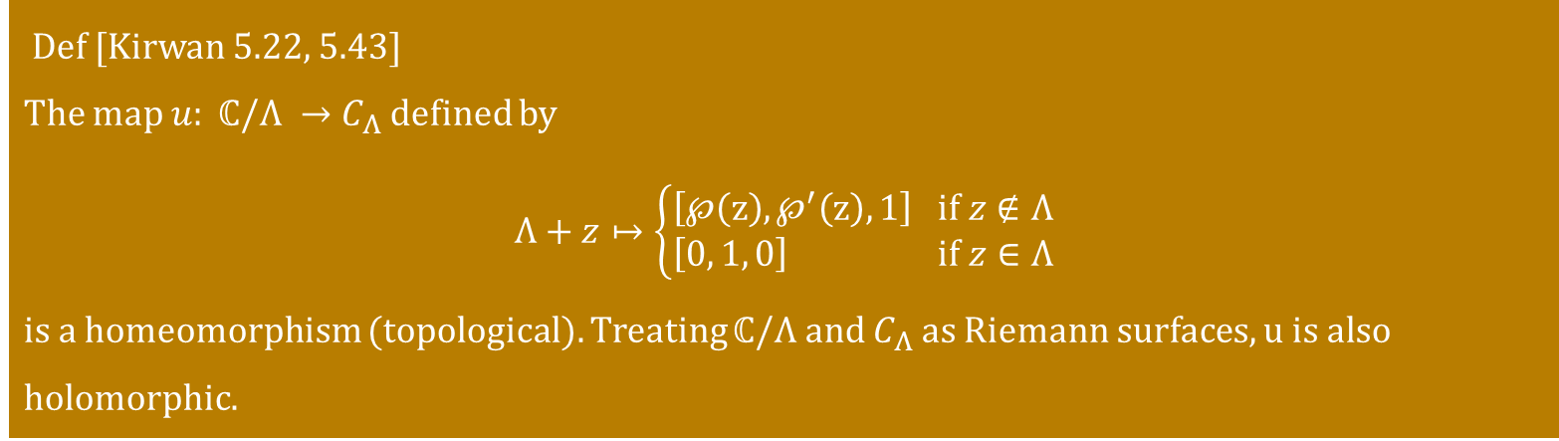
Holomorphic map $u: ℂ/Λ →C_{Λ}$
Def [Kirwan 5.22, 5.43]
The map $u: ℂ/Λ →C_{Λ}$ defined by
$$Λ+z↦\left\{\begin{aligned}\left[℘\left(z\right), ℘^{′}\left(z\right), 1\right] if z∉Λ \\ \left[0, 1, 0\right] if z∈Λ\end{aligned}\right.$$
is a homeomorphism (topological). Treating $ℂ/Λ and C_{Λ}$ as Riemann surfaces, u is also holomorphic.
Insert Image for proof

Slide 24
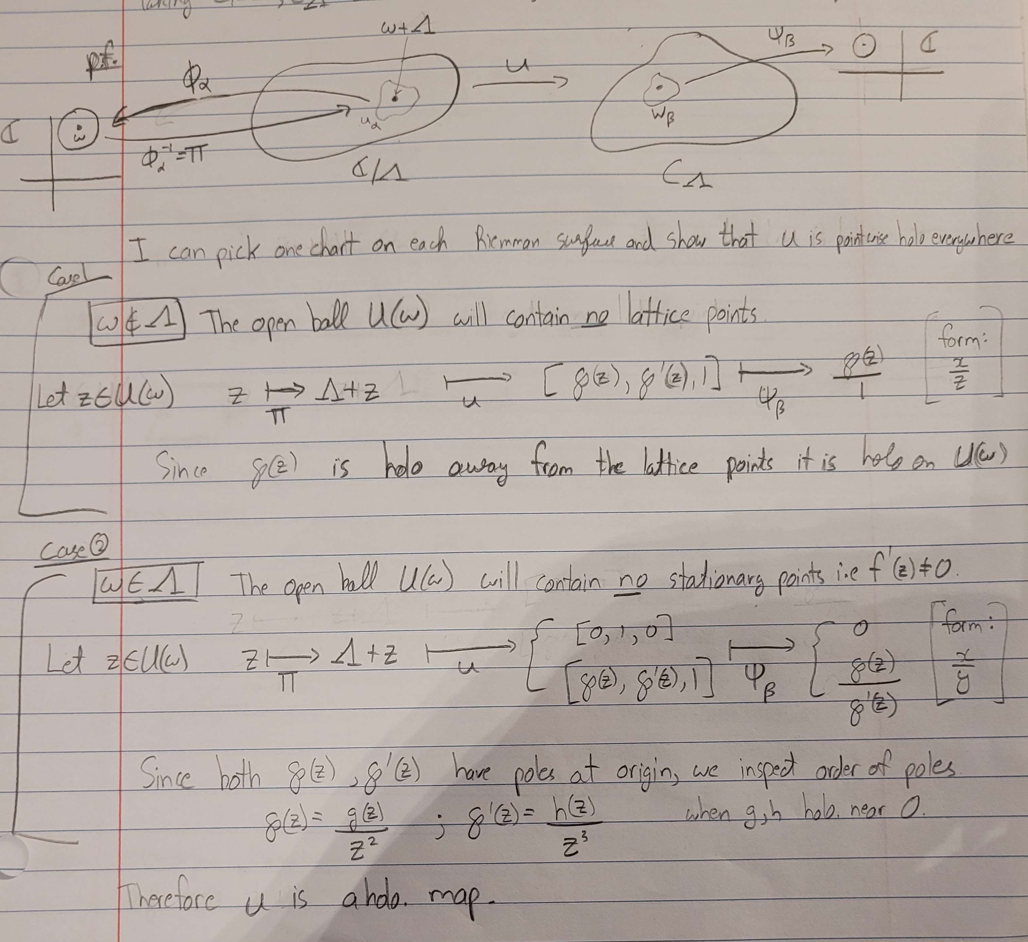




















Slide 25

Summary
Elliptic functions are doubly periodic, meromorphic functions
Non-singular projective curves are compact Riemann surfaces
Used the Weierstass elliptic function $℘$ to prove conformal equivalence between a complex torus and a projective curve defined on a given lattice

Slide 26
Sources
F. Kirwan, Complex Algebraic Curves
A.F. Beardon, A Primer on Riemann Surfaces
G. Pastras, Four Lectures on Weierstrass Elliptic Function and Applications in Classical and Quantum Mechanics

Slide 27

Thank You for Listening Any Questions?

